Slide 1
Common IRB Related Audit Findings Patrick Herbison, MEd, CIP patrick.herbison@jefferson.edu

Slide 2
Quality Improvement (QI) Conducts Study Audits
Similar to an FDA inspection
Provide CAPAs to the study team for their own QI efforts
During prep for JCRF, some findings of interest to IRB/OHR were identified
Quality Feedback Loop
PIs/Coordinators
Conduct Studies
JCRI
Educate
QI Group
Audit

Slide 3
Hanlon’s Razor
“Never attribute to malice that which is adequately explained by stupidity.”
Deception Mistakes
VS.

Slide 4
IRB Submissions
IRB submissions contain: and
Reasons:
Mistakes/Sloppiness
Inexperience
Multiple people working on submission
Similar info in different places

Slide 5
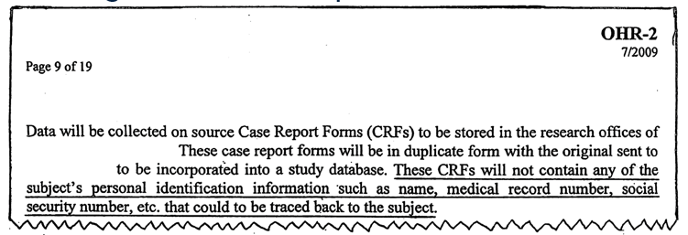
Examples of Submissions vs. Reality
Enrolling more subjects than study was approved for
Submitting a specific consent form (e.g. surrogate, assent) but using it inconsistently
Missing some procedures indicated in the protocol
Collecting more PHI than specified

Slide 6
IRB Reviewer Forms
To ensure ‘pertinent regulatory determinations’ are made when reviewing studies
Review for ‘good science’ and protection of subjects
To help standardize reviews (e.g. RQ-E1: 20 Possible elements of consent - 45 CFR 46.116)
RQ-1: Reviewer Questionnaire for Initial and Continuing Review
RQ-2: Reviewer Questionnaire for Research Involving the Department of Defense
RQ-3: Reviewer Questionnaire for Expedited Continuing Reviews
RQ-4: Reviewer Questionnaire for Exempt Reviews
RQ-B1: Reviewer Questionnaire for Research Involving Pregnant Women or Fetuses
RQ-B2: Reviewer Questionnaire for Research Involving Neonates of Uncertain Viability
RQ-B3: Reviewer Questionnaire for Research Involving Non-Viable Neonates
RQ-B4: Reviewer Questionnaire for Research Involving Fetal Material
RQ-C1: Reviewer Questionnaire for Research Involving Prisoners
RQ-E1: Reviewer Checklist for Informed Consent Procedure and Documentation
Note: The reviewer forms are not mandated by OHR Policy

Slide 7
Reviewer Forms
https://www.jefferson.edu/university/human_research/members/materials.html

Slide 8
Study Expiration and Lapses
No research procedures/activities may occur after expiration of IRB approval/during a lapse in IRB approval (Except to eliminate an apparent immediate hazard to subjects - 21 CFR 312.30)
If you notice a lapse, and it’s likely the study continued, inform QI
9/14/2021
IRB
Approval Expires
9/15/2020
Study Approved
LAPSE
10/1/2021
Study
Re-Approved

Slide 9
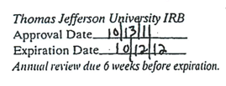
Approval Stamps on Consent Forms
The most recent, IRB approved, stamped consent form should be used for the consent process
The stamp is needed to ensure that the right version will be used

Slide 10
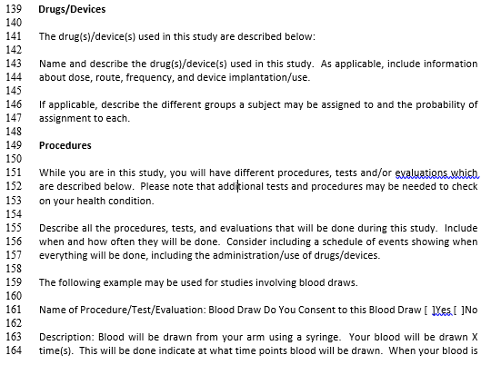
Checkboxes in the Body of the Consent Form

Slide 11
Checkboxes in the Body of the Consent Form

Slide 12
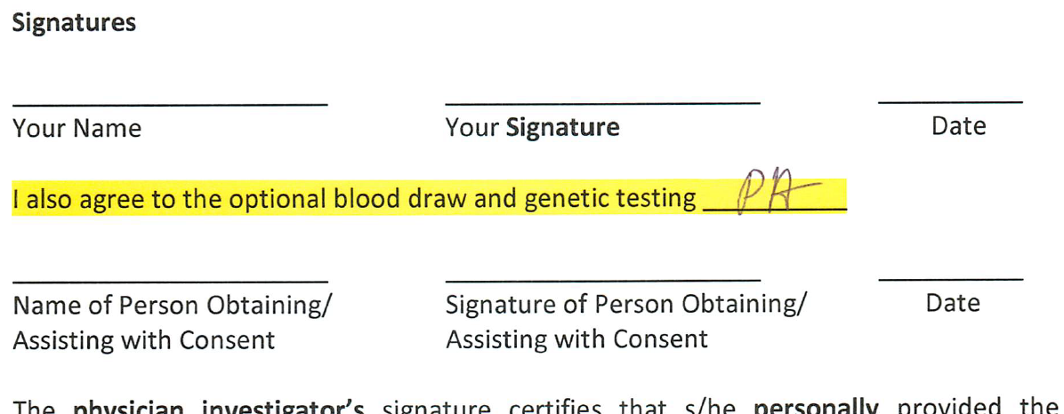
Checkboxes in the Body of the Consent Form
This never ends well
It’s forgotten and that part of the study can’t be done
The default should be participating in ALL parts of the study (by signing the consent)
If there must be an optional procedure, put it on the signature page and require initials, not a checkbox

Slide 13
Short Form Consent Process
The other thing that never ends well.
Using the short form consent process for anything other than unanticipated, non-English speaking subjects
It is allowed by regulations, but never ends well because it is actually more complicated than regular consent
Short Form Process = 2 forms + 5 signatures including a Witness
vs.
Regular Consent = 1 form + 3 Signatures
If short form process is submitted, ask them why, and see if an abbreviated regular consent form would work.

Slide 14
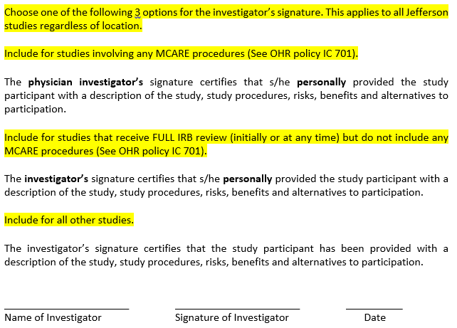
MCARE
Defining the Investigator’s Responsibility when Signing the Consent
Prompt in OHR-2

Slide 15
MCARE
Slideshow Announcement on MyJeffHub
MCARE, the Pennsylvania law regarding informed consent has recently changed. It now allows for some degree of delegation of the informed consent discussion. The Office of Human Research (OHR) is aware of this change, however, OHR policy is dependent on Hospital policy. When the Hospital policy has been revised, OHR will revisit this issue and revise policies and forms as needed.
Until then, the current OHR policies and forms remain in effect.

Slide 16
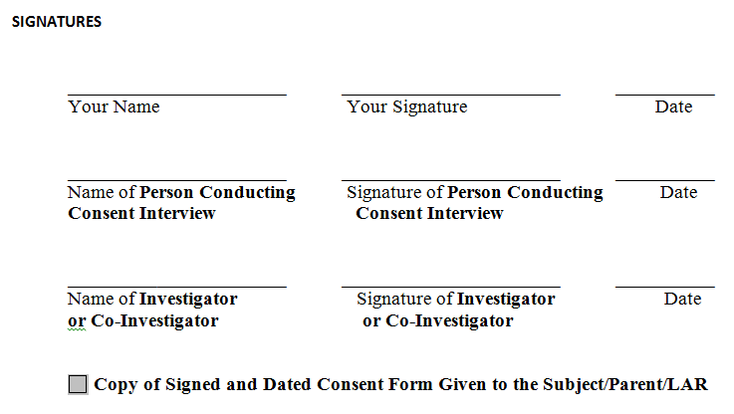
Copy of Consent Given to Subject
Version 1
Version 2

Slide 17
AE Reporting (OHR Policy GA 120)
An Adverse Event (AE) is any untoward medical occurrence that occurs during the reporting time period (see more below). The occurrence does not have to be related to the study and includes abnormal laboratory findings.
EVENT | Business Days
An adverse event that meets ALL of these criteria: Serious [Grades 3,4,5 (death)] Unexpected (in specificity / severity / frequency) Possibly or Definitely Related | 5
An unanticipated problem (UAP) that meets ALL of these criteria: Involves risk to the subject(s) or others Is serious | 5
All AEs, SAEs, and UAPs | Report with the next continuing review or final report (whichever comes first): All SAEs and UAPs that have occurred since the initial submission or last continuing review (whichever was more recent). This includes SAEs and UAPs that have already been submitted to the IRB. Note that grade 1 and 2 AEs do not have to be reported to OHR.

Slide 18
AE Reporting (OHR Policy GA 120)
AEs are used to determine safety
You can’t analyze what you didn’t record
These shouldn’t be ‘pre-screened’
Note: Protocols often specify events that will not be reported as AEs/SAEs
However, when a continuing review is submitted, if your not seeing an appropriate number of AEs submitted, this may be an indication they are not recording all AEs
The FDA uses this as a trigger for inspections
Notify QI if you see a big discrepancy

Slide 19
Amendments
IRB Determinations: One and Done?
No Further Continuing Review (NFCR)
Exempt
Approved Until ‘End of Study’ (recruitment materials, questionnaires)
Even for these categories, if revisions are needed, an amendment is required

Slide 20
Reviewer Comments
Touched on by Kyle at last CE
Reviewer Comment: “This is not a great study, but it’s low risk, so it can be approved.”
Reviewer Comments
Where your comment will be seen by:
Jefferson Auditors
AAHRPP Reviewers
FDA Inspectors
Email to PI
Study File
Meeting Minutes

Slide 21
Review Submissions Carefully
VS.

Slide 22
Thank you! Questions?

