Slide 1
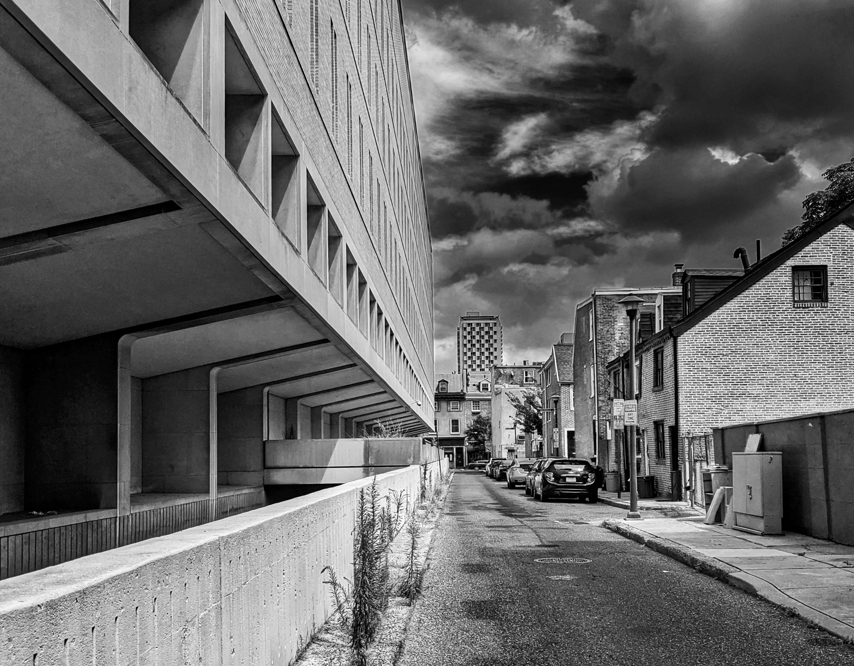
The lessons of history
IRB continuing education
Walter Kraft, MD

Slide 2
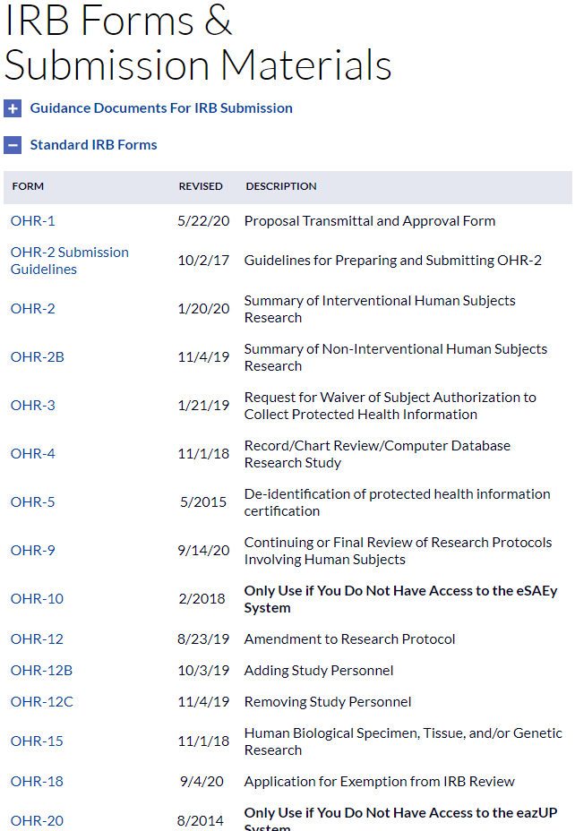
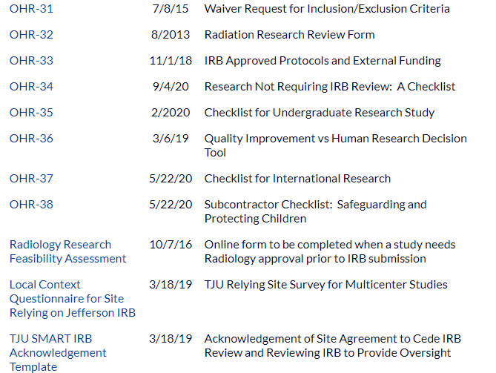
Not a talk about forms

Slide 3
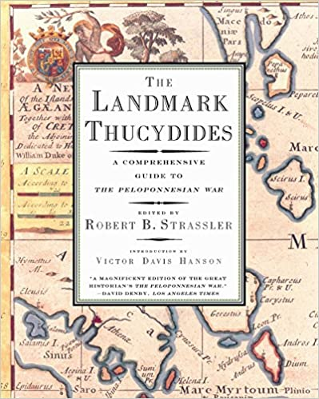
History
Is this relevant?
“History and physical”
Thucydides (Born 460 BC)
Culture changes, but the nature of humans has permanence

Slide 4
Consent in Common Law
Richard Slater fell from horse in 1767
2 surgeons allegedly rebroke healing callus in treatment without consent
Really a medical malpractice case, but court expressed the reasons for the requirement of consent in surprisingly modern terms
“indeed it is reasonable that a patient should be told what is about to be done to him, …to enable him to undergo the operation…”

Slide 5
Yellow fever: No good animal model
1887: Sanarelli announced discovery of bacillus of yellow fever and by injection had caused the disease in 5 patients, 3 of whom died
Osler in public meeting
“To delivery inject a poison of high degree of virulency into a human being, unless you obtain the man’s section, is not ridiculous, it is criminal”
Source: E. Emanuel

Slide 6
1901: Walter Reed leads Yellow Fever Board
Research ethics principles
  Self experimentation
  Written agreements with subjects
  Payment $100 in gold and additional $100 if subjects got ill ($100 = $3,000 current equivalent)
  Adults only
  Phrase “with his full consent” was used in all journal articles
  29 subjects became ill, 5 died
  Many participated as they thought they would get infected regardless
  Studies confirmed mosquito as vector
https://highschoolbioethics.georgetown.edu/units/cases/unit3_5.html

Slide 7
And we all lived happily ever after…..

Slide 8
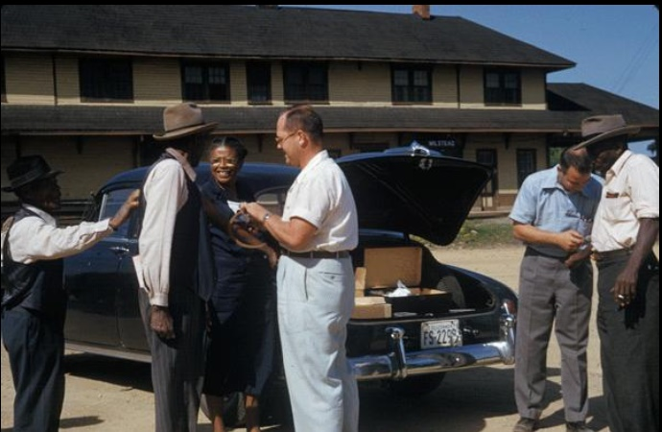
Tuskegee Syphilis Study
Started in 1929
  State of art TX: mercury and arsenic, 30% cure rate
  Great Depression impacted funding
  Treatment dropped; just observational
Blacks in Tuskegee (Macon County), Alabama, with Syphilis were left untreated but were observed, studied and compared to a control group
Government sponsored
Source National Archives https://catalog.archives.gov/id/281640

Slide 9
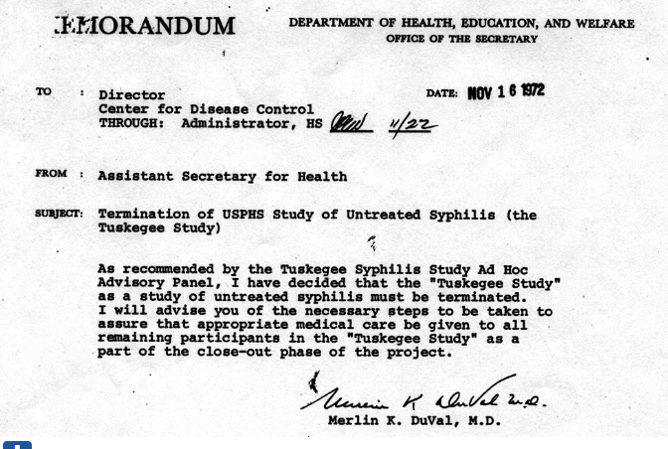
Details
Participants told study was about “bad blood”
1947: penicillin available
1968: Peter Buxtun raises issue
1969: CDC reaffirms need for study, endorsed by AMA and NMA
1972: Press reports
1974: out of court settlement
  Lifetime medical benefits
  Burial costs

Slide 10
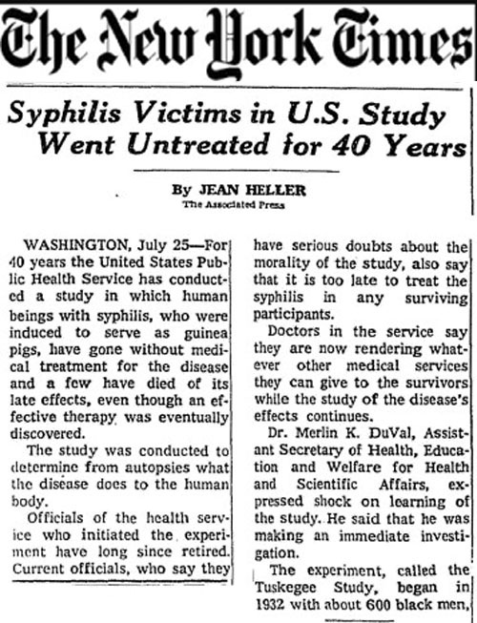
Peter Buxtun
Degree in European history, served as Army psychiatric social worker
1966: venereal disease investigator for USPHS
Wrote report 1968 comparing project to Nuremburg Doctors Trials experiments
His immediate supervisor. “I’ll send your report up the line, but remember I have a wife and kids. Please forget my name when they ask you why you did this.”
Exasperated, went to the press

Slide 11
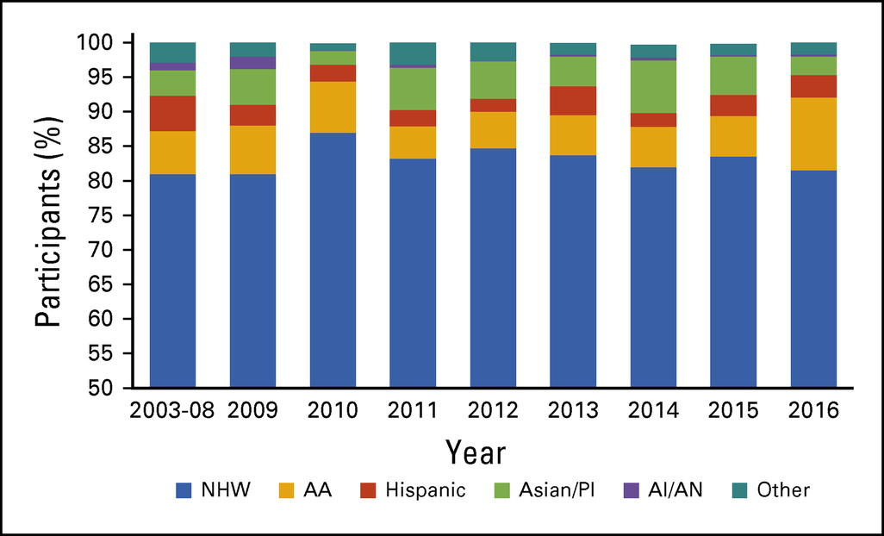
Afterglow
Underrepresentation in research
  AA 7% of cancer trials in 2009
  5.5% btwn 2011-15
Trust
Failing to reap the benefit of clinical trial participation
Duma N, Vera Aguilera J, Paludo J, et al: Representation of Minorities and Women in Oncology Clinical Trials: Review of the Past 14 Years. J Oncol Pract. 14:e1-e10,2018.

Slide 12
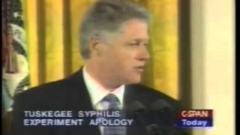
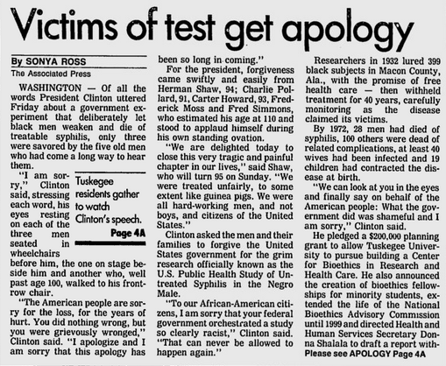
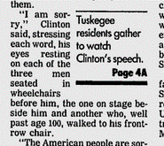
How do we keep research ethical?
Build a culture
What was the culture of the US Public Health Service
  “The longer the study, the better the ultimate information we would derive”
  “Making a mountain out of a mole hill”
How do we build a culture?
  Education
  Explicit in guard rails
We as society accept responsibility

Slide 13
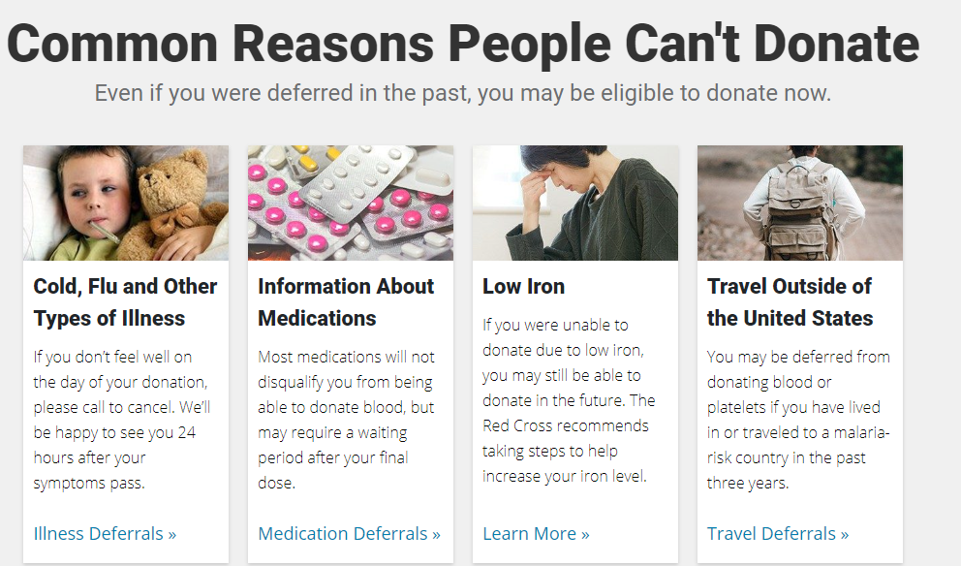
Trust
The whole enterprise depends upon trust
Contract between us and society

Slide 14
How does society establish what is ethical?
Thank you for not sinning
And taking citi training w/o being asked

Slide 15
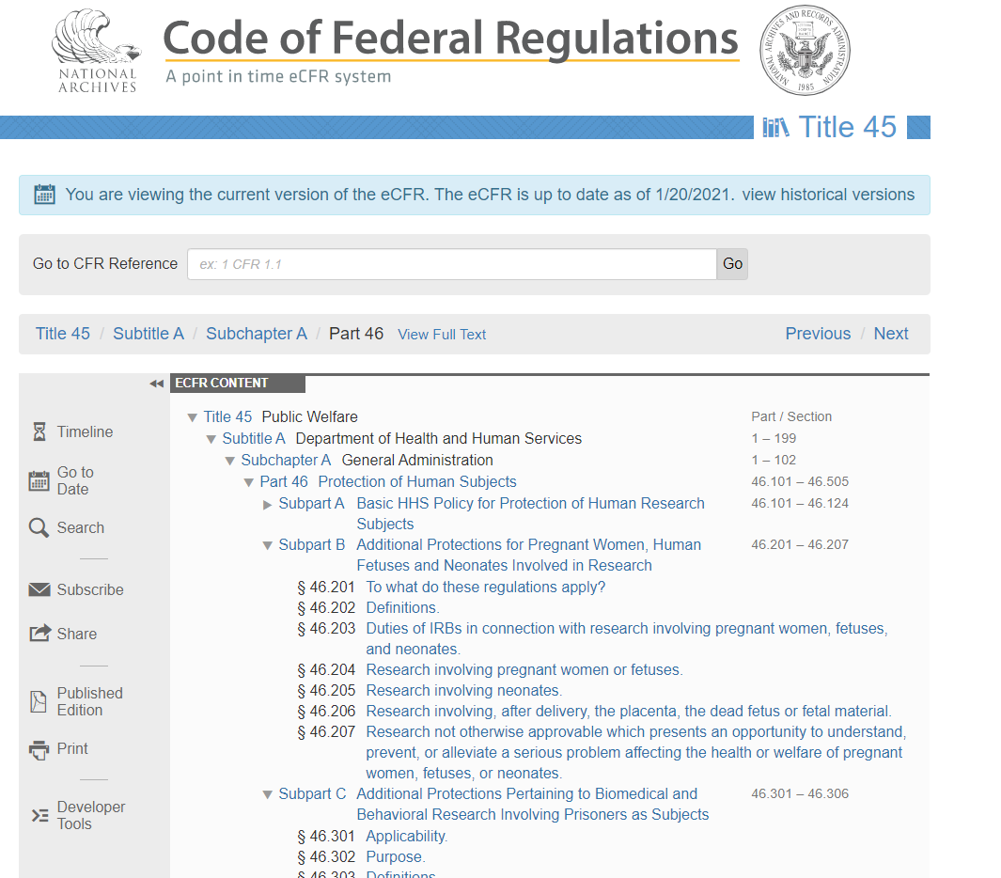
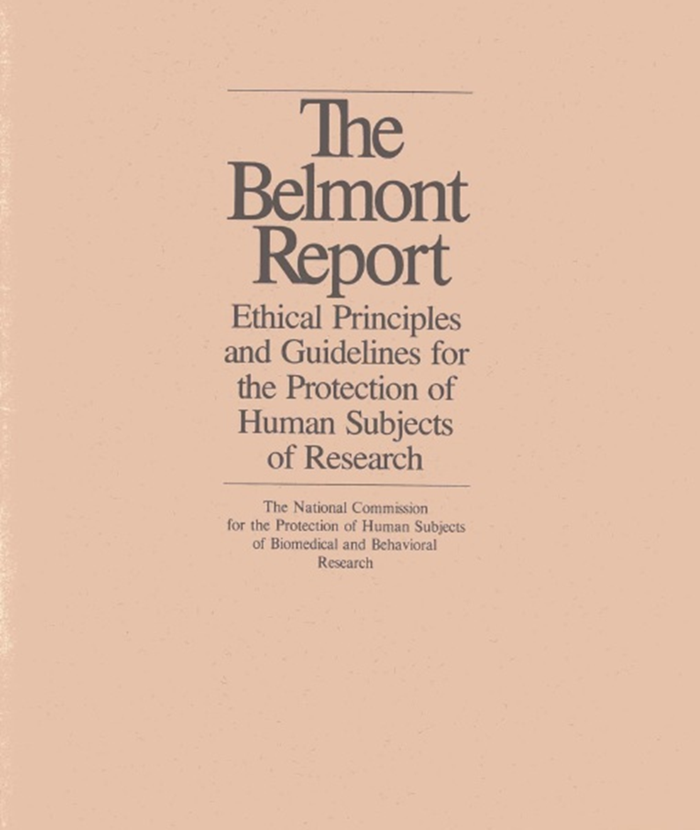
How does society establish what is ethical?

Slide 16
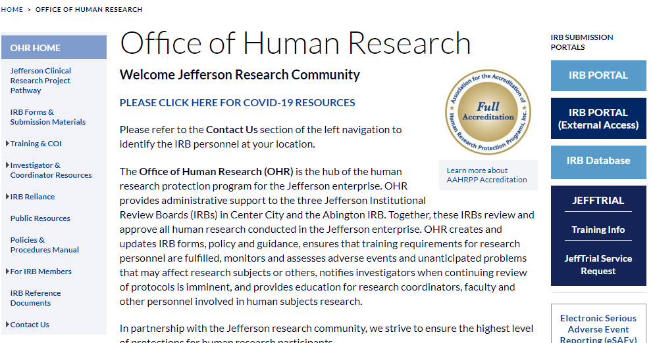
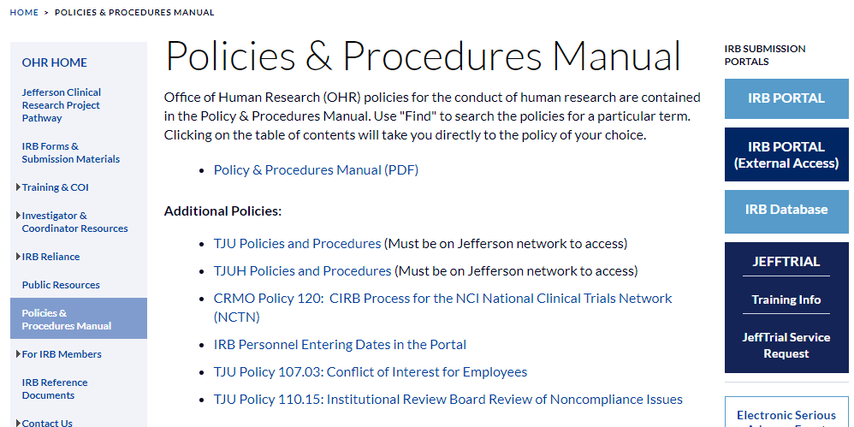
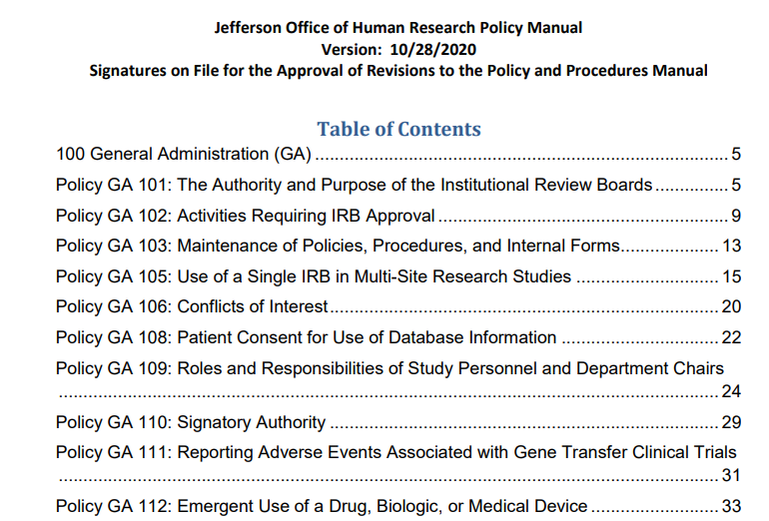
Local Policies

Slide 17
8 Ethical Requirements
Collaborative partnership
Social value
Scientific validity
Fair subject selection
Favorable risk benefit ratio
Independent Review
Informed consent
Respect for human subjects

Slide 18
Category | Risk | Who reviews
Not research | Minimal | PI
Research not subject to IRB review | Minimal | PI, except coded data
Exempt | Minimal | OHR office
Expedited | Minimal | OHR office
Full | > than minimal | Full IRB board

