Slide 1

Basic Pharmacokinetics
Walter Kraft
IRB Education

Slide 2
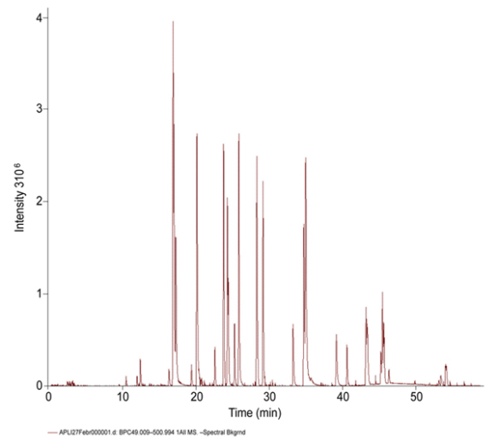

Pharmacokinetics: what does the body do to the drug?
digoxin levels in plasma
Pharmaco-kinetics
Term derived from
the Greek word roots
Relatively modern discipline
developed in tandem with
analytical sciences

Slide 3
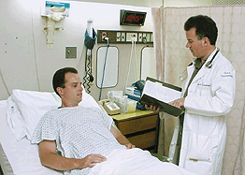
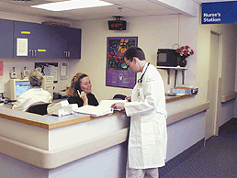
Descriptive Data
Drug administered, concentrations measured at set times over the next few hours

Slide 4
Graph: linear axis
C_{max}
T_{max}

Slide 5
AUC₍₀₋₂₄₎

Slide 6
AUC_{(0-ϖ)}
AUC_{(24-ϖ)}
AUC₍₀₋₂₄₎

Slide 7
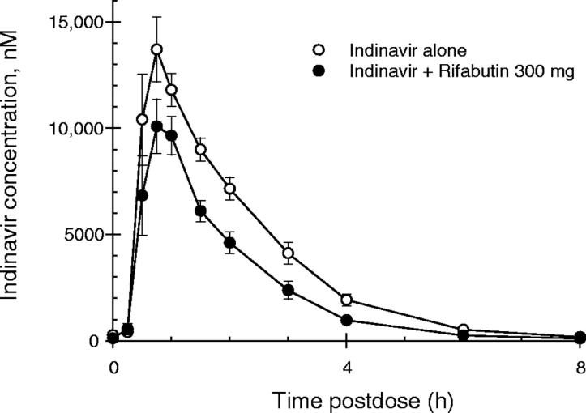
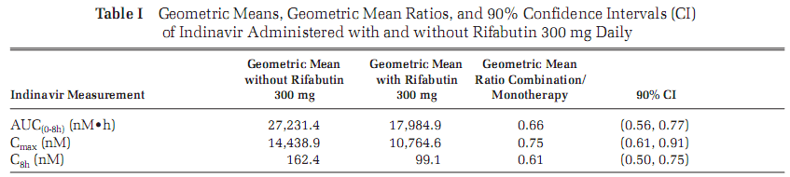
Drug interaction study
Kraft WK, et al. J Clin Pharmacol 2004

Slide 8
Approaching Steady State
C_{A}
C_{T}
C_{V}
At the beginning of the infusion C_{A} > C_{V} Distribution Phase
C_{A} = concentration in artery C_{T} = concentration in tissue
C_{V} = concentration in artery

Slide 9
At Steady State
C_{A}
C_{T}
C_{V}
At the beginning of the infusion C_{A} > C_{V} Distribution Phase
At steady state infusion C_{A} = C_{V} Equilibrium

Slide 10
Leaving Steady State
C_{A}
C_{T}
C_{V}
At the beginning of the infusion C_{A} > C_{V} Distribution Phase
At steady state infusion C_{A} = C_{V} Equilibrium
At the end of infusion C_{A} < C_{V} Elimination Phase: redistribution out of tissue

Slide 11
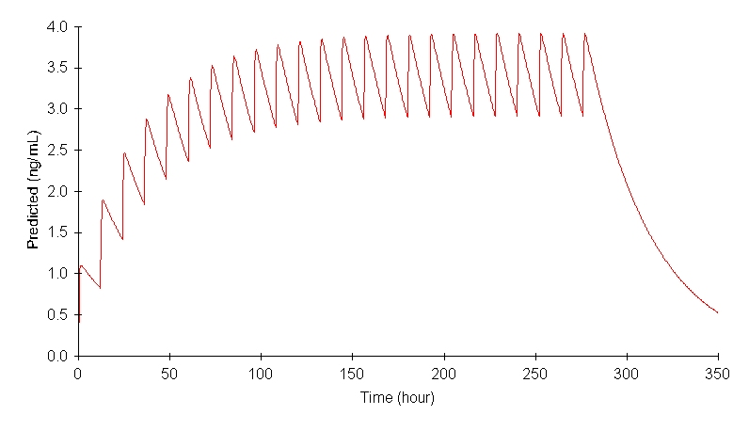
Multiple dose administration

Slide 12
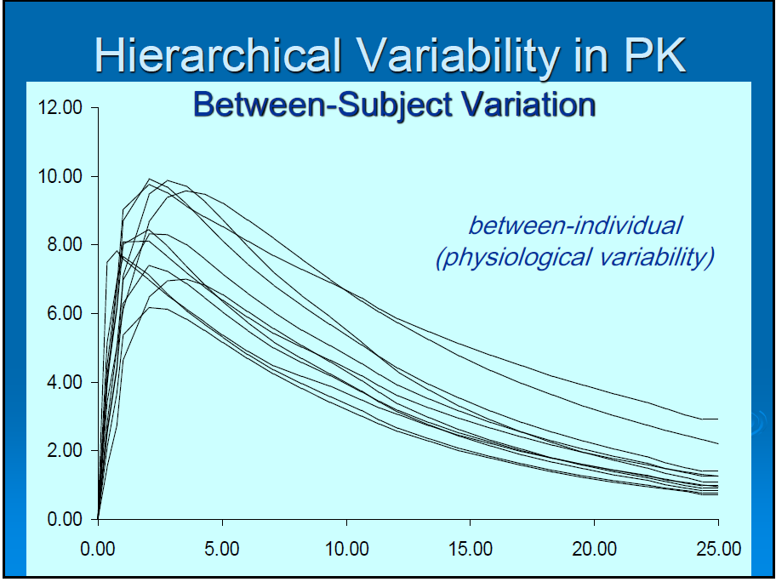

Slide 13
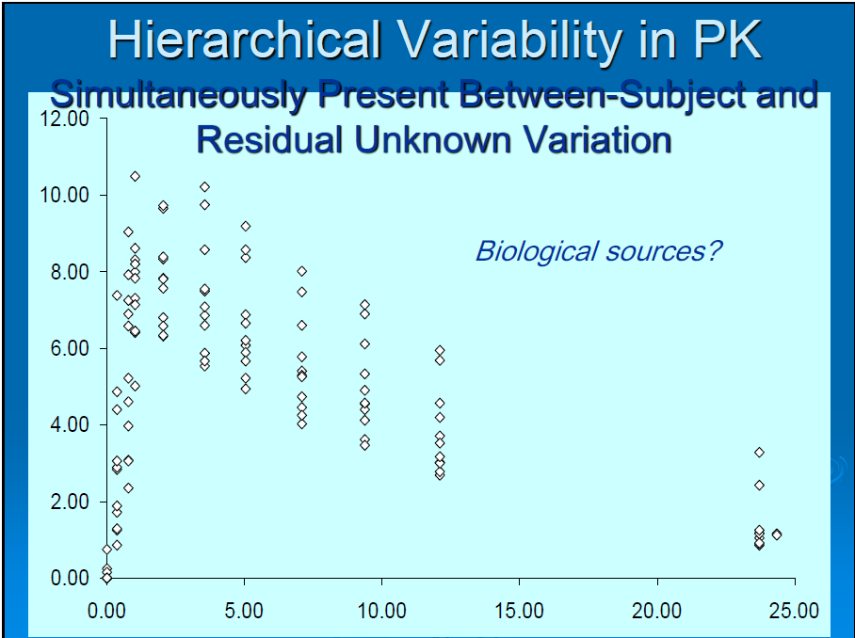

Slide 14
Linear Axis
75
Linear Decline: zero order
50
25
Exponential Decline: First order
Time

